Slide 1



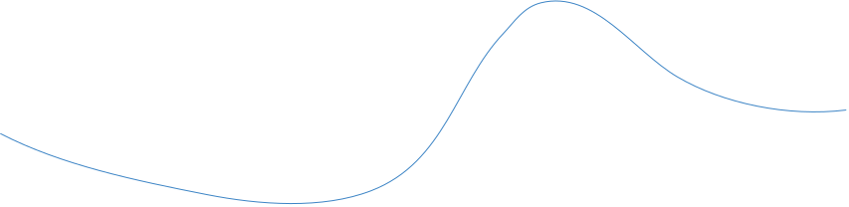
بركن

Slide 2



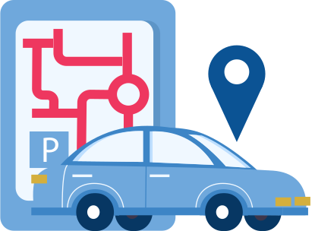
The Smart Parking System is the ideal solution to enhance the parking experience during entertainment seasons and major events.

Slide 3

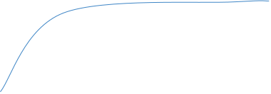
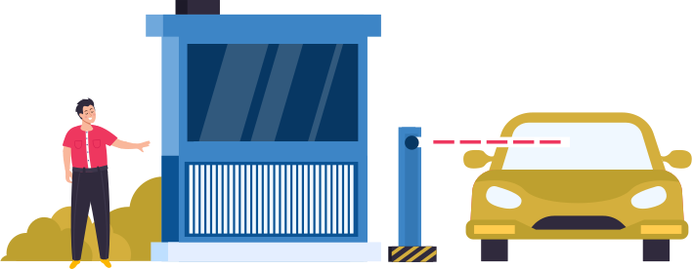
Problem / solution

Slide 4



The problem
Seasonal events and entertainment seasons suffer from:
Severe congestion in parking lots.
Difficulty finding vacant parking spots.
Loss of time and increased stress for visitors.
Congestion in parking lot aisles due to poor guidance.

Slide 5
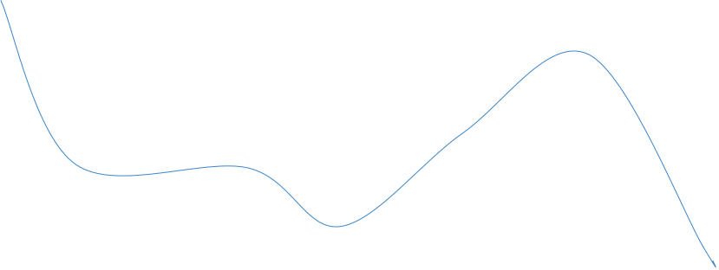

Solution
To simplify and organize the process of finding available parking spots.
How does work?
Detects available and occupied spaces.
Guides visitors to the nearest available parking spot via screens.
Reduces congestion and improves the overall visitor experience.

Slide 6
1
Dataset and Demo

Slide 7


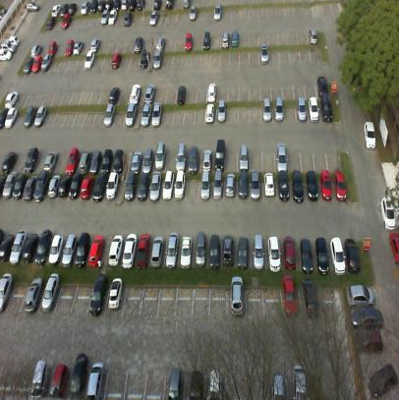


Our dataset contains 1297 images
Train: 909 images
Valid: 260 images
Test: 128 images
All Resized to 640.

Slide 8
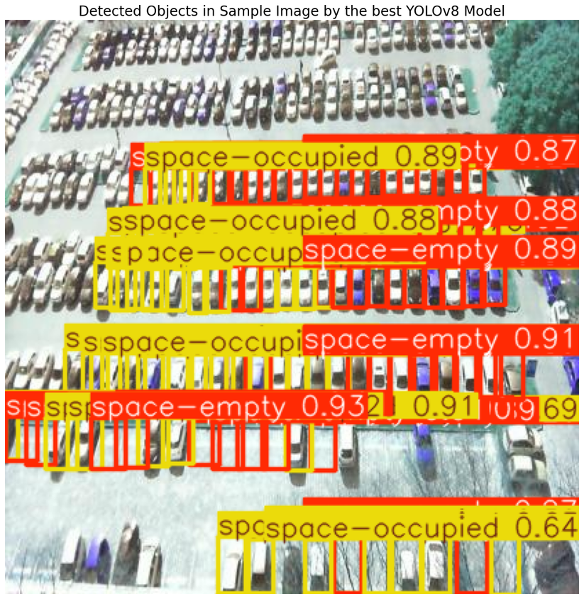
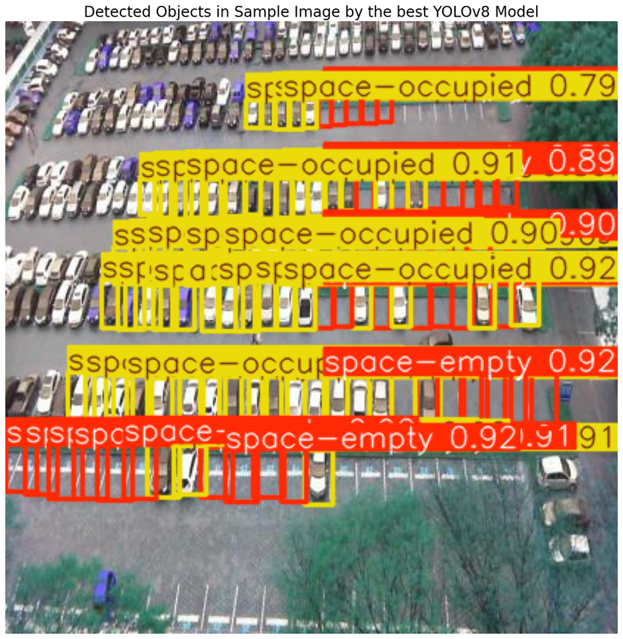
Testing on test set

Slide 9
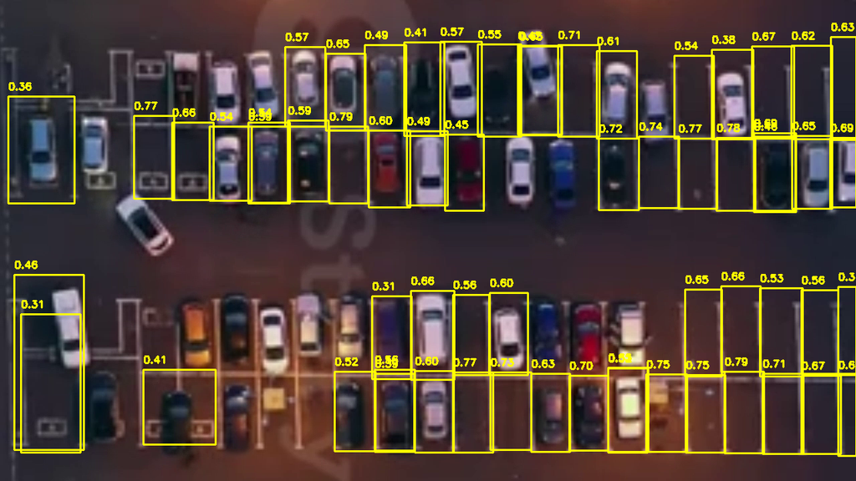
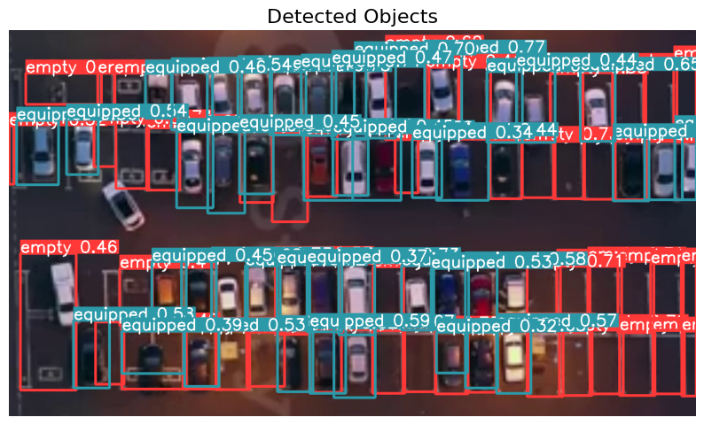
Testing on vid
Yolov8 Yolov8 with SAHI

Slide 10
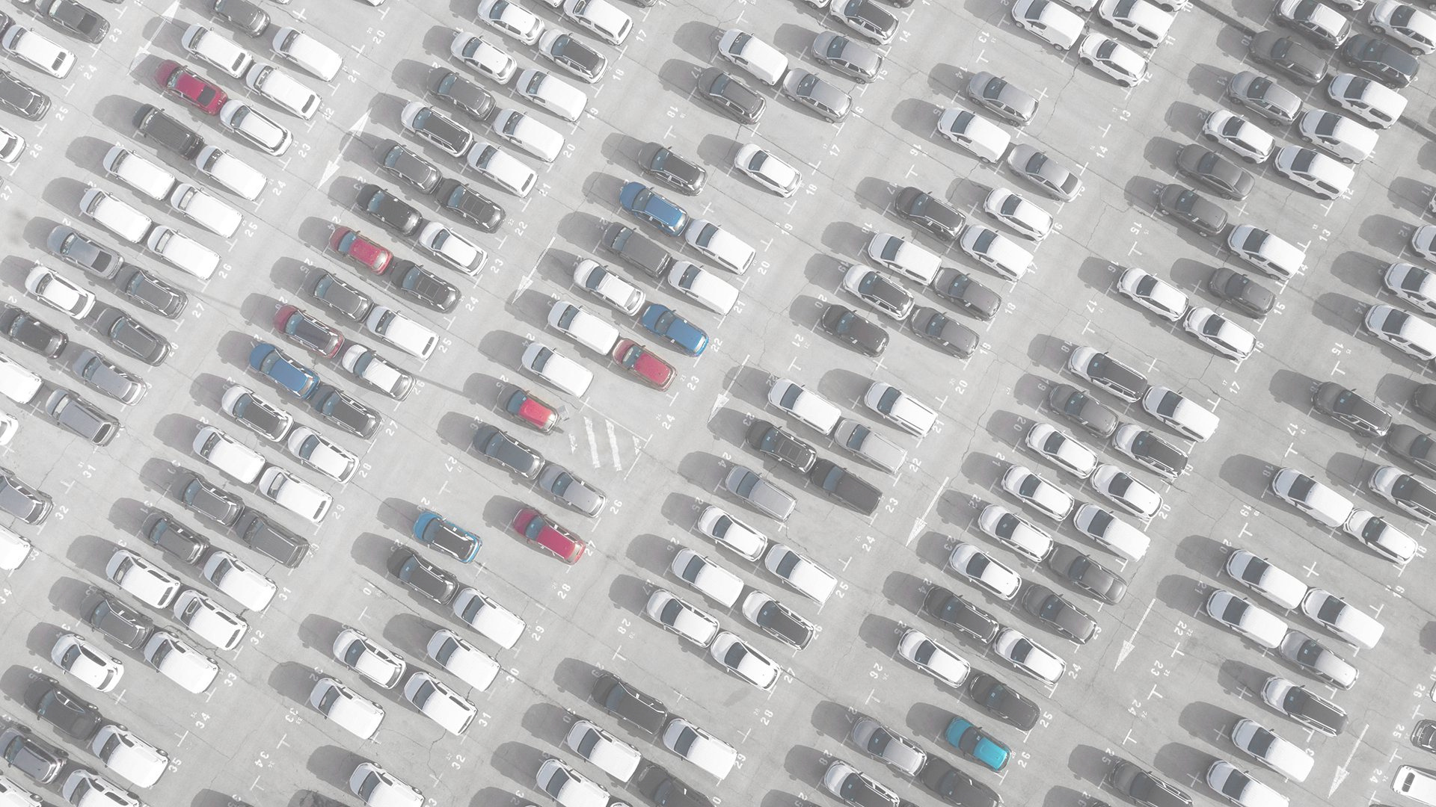
Our team
Rawan alghamdi
Adwa Alshehri
Alawi Alalawi
Naif Alsabhan

Slide 11



Thanks!

